Slide 1
COMP 2230
Week 10 - Friday

Slide 2
Last time
Matrix representations of graphs
Graph isomorphism

Slide 3
Questions?

Slide 4
Assignment 5

Slide 5
Logical warmup
Jean and Gene have fallen in love on a dating app (without meeting in person)
Gene wants to mail Jean an engagement ring
These days, the mail has become increasingly subject to theft, and anything will be stolen unless it's sent in a locked box
Jean and Gene each have plenty of padlocks, but neither has a key to any of the other one's locks
How can Gene get the ring safely to Jean?

Slide 6
Back to Matrices for a Second

Slide 7

Finding powers of a matrix
$$A=\left[\begin{matrix}1 & 2 \\ 2 & 0\end{matrix}\right]$$
Compute $A^{0}$
Compute $A^{1}$
Compute $A^{2}$

Slide 8
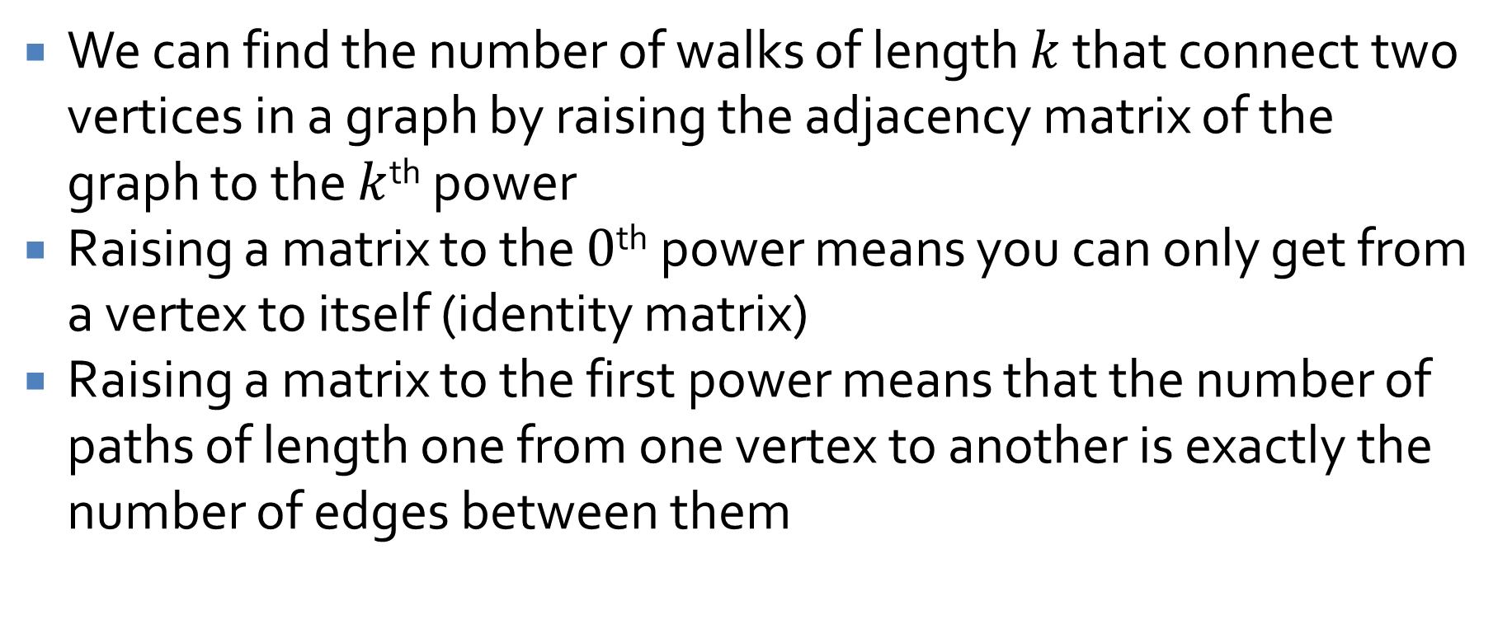
Matrix powers for graphs
We can find the number of walks of length $k$ that connect two vertices in a graph by raising the adjacency matrix of the graph to the $k$^{th} power
Raising a matrix to the $0$^{th} power means you can only get from a vertex to itself (identity matrix)
Raising a matrix to the first power means that the number of paths of length one from one vertex to another is exactly the number of edges between them

Slide 9
Trees, Rooted Trees, and Spanning Trees
Three-Sentence Summary

Slide 10
Trees

Slide 11
Trees
A tree is a graph that is circuit-free and connected
Three examples:
A graph made up of disconnected trees is called a forest

Slide 12
Applications of trees
Trees have almost unlimited applications
You should all be familiar with the concept of a decision tree from programming
> 10
Math 120
Score on Part II
> 10
Math 110
≤ 10
Score on Part I
= 8, 9, 10
Score on Part II
> 6
Math 110
< 8
Math 100
≤ 6
Math 100

Slide 13
Parse trees
A grammar for a formal language (such as we will discuss in a couple of weeks) is made up of rules that allow non-terminals to be turned into other non-terminals or terminals
For example:
  <sentence> → <noun phrase><verb phrase>
  <noun phrase> → <article><noun> | <article><adjective><noun>
  <verb phrase> → <verb><noun phrase>
  <article> → a | an | the
  <adjective> → funky
  <noun> → DJ | beat
  <verb> → plays | spins
Make a parse tree corresponding to the sentence, "The DJ plays a funky beat"

Slide 14
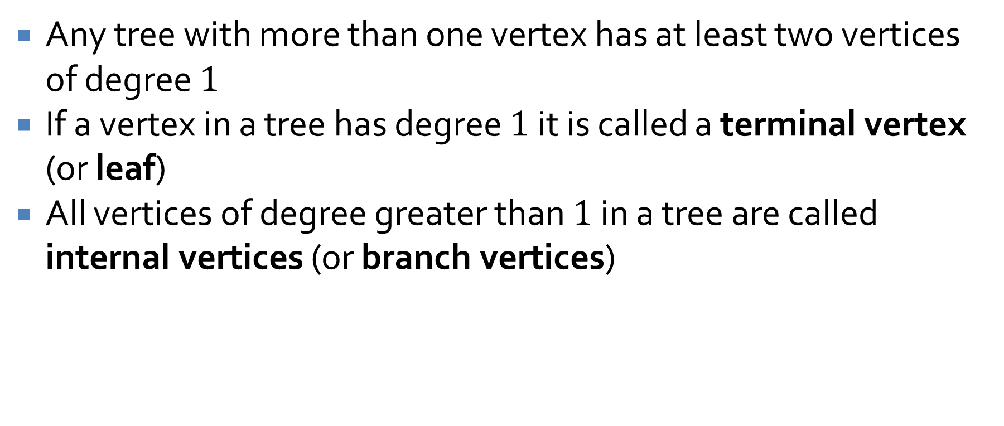
Describing trees
Any tree with more than one vertex has at least two vertices of degree $1$
If a vertex in a tree has degree $1$ it is called a terminal vertex (or leaf)
All vertices of degree greater than $1$ in a tree are called internal vertices (or branch vertices)

Slide 15

A property of trees
For any positive integer $n$, a tree with $n$ vertices must have $n –1$ edges
Prove this by mathematical induction

Slide 16
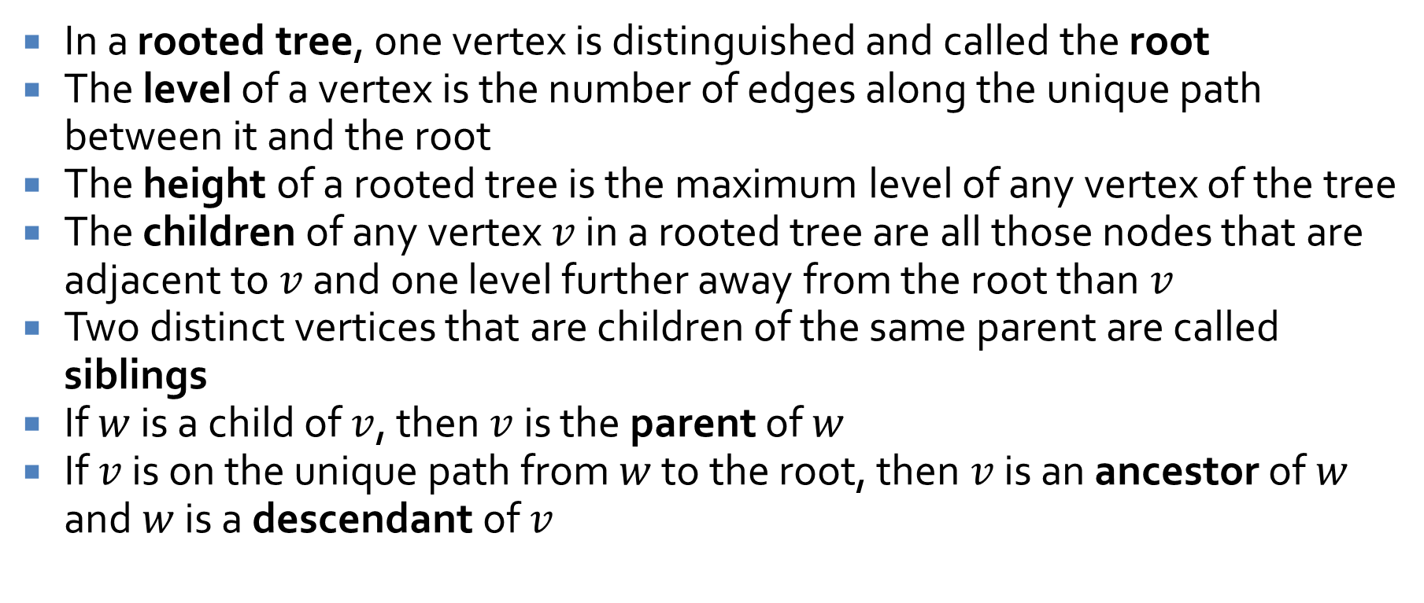
Rooted trees
In a rooted tree, one vertex is distinguished and called the root
The level of a vertex is the number of edges along the unique path between it and the root
The height of a rooted tree is the maximum level of any vertex of the tree
The children of any vertex $v$ in a rooted tree are all those nodes that are adjacent to $v$ and one level further away from the root than $v$
Two distinct vertices that are children of the same parent are called siblings
If $w$ is a child of $v$, then $v$ is the parent of $w$
If $v$ is on the unique path from $w$ to the root, then $v$ is an ancestor of $w$ and $w$ is a descendant of $v$

Slide 17

Rooted tree example
Consider the following tree, rooted at $0$
What is the level of $5$?
What is the level of $0$?
What is the height of this tree?
What are the children of $3$?
What is the parent of $2$?
What are the siblings of $8$?
What are the descendants of $3$?
0
3
4
1
2
6
5
7
9
8

Slide 18
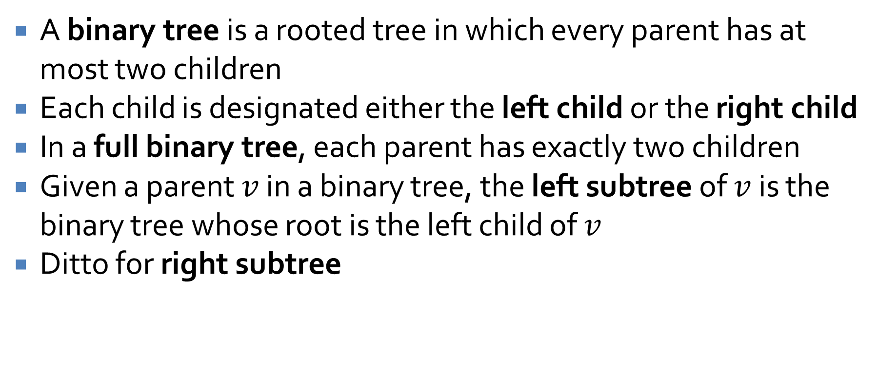
Binary trees
A binary tree is a rooted tree in which every parent has at most two children
Each child is designated either the left child or the right child
In a full binary tree, each parent has exactly two children
Given a parent $v$ in a binary tree, the left subtree of $v$ is the binary tree whose root is the left child of $v$
Ditto for right subtree

Slide 19
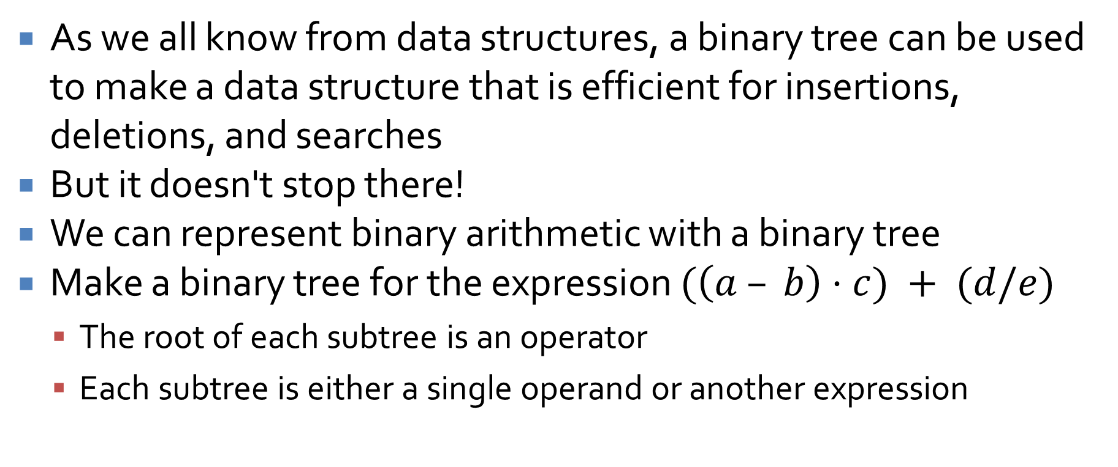
Binary tree applications
As we all know from data structures, a binary tree can be used to make a data structure that is efficient for insertions, deletions, and searches
But it doesn't stop there!
We can represent binary arithmetic with a binary tree
Make a binary tree for the expression $(\left(a – b\right)⋅c) + (d/e)$
  The root of each subtree is an operator
  Each subtree is either a single operand or another expression

Slide 20
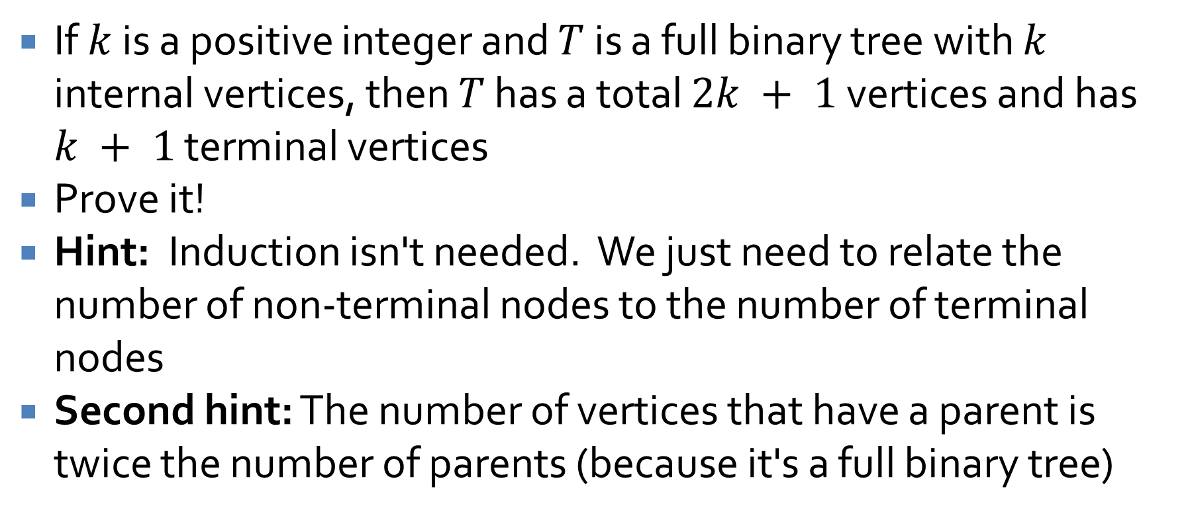
Full Binary Tree Theorem
If $k$ is a positive integer and $T$ is a full binary tree with $k$ internal vertices, then $T$ has a total $2k + 1$ vertices and has $k + 1$ terminal vertices
Prove it!
Hint: Induction isn't needed. We just need to relate the number of non-terminal nodes to the number of terminal nodes
Second hint: The number of vertices that have a parent is twice the number of parents (because it's a full binary tree)

Slide 21
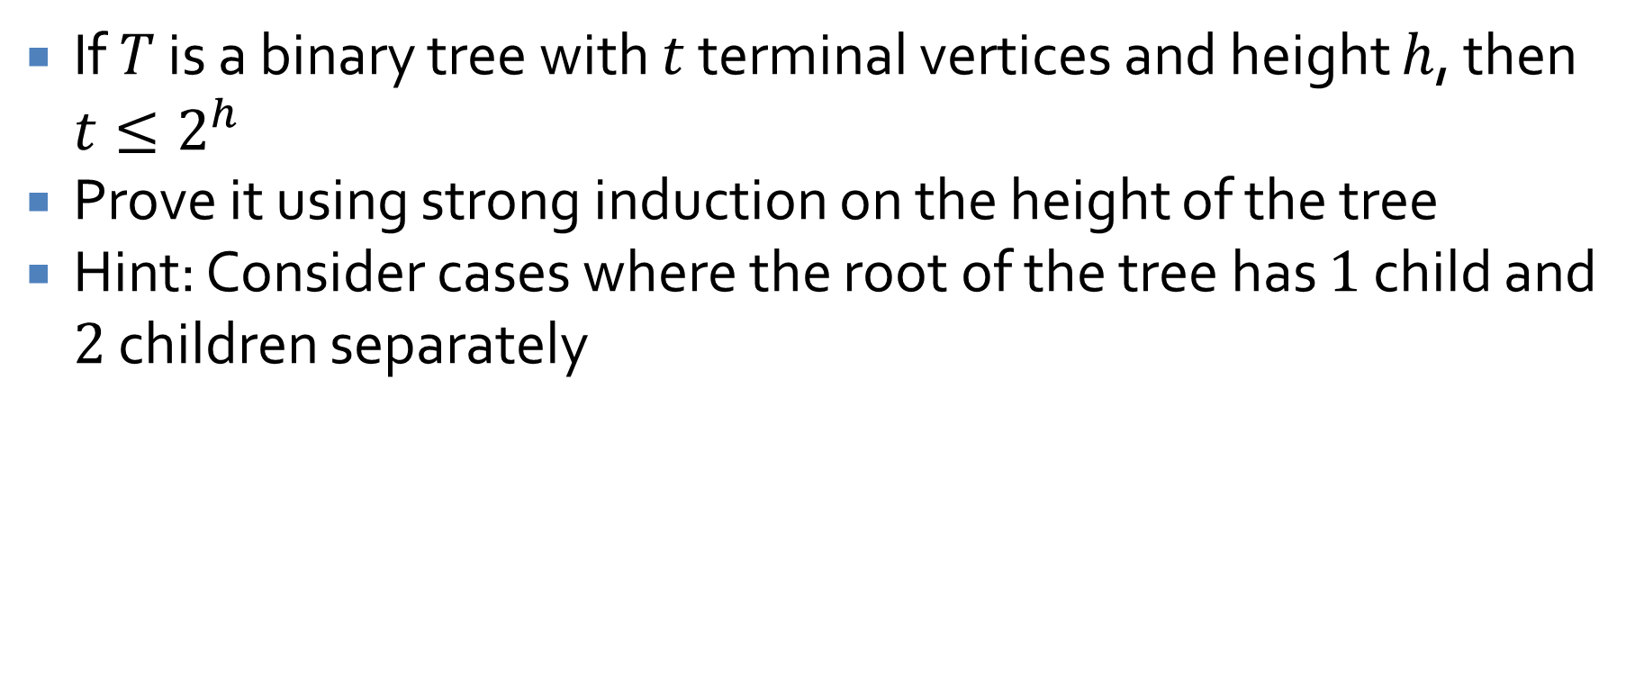
Leaves in a tree
If $T$ is a binary tree with $t$ terminal vertices and height $h$, then $t≤2^{h}$
Prove it using strong induction on the height of the tree
Hint: Consider cases where the root of the tree has $1$ child and $2$ children separately

Slide 22
Spanning Trees

Slide 23
Turning graphs into trees
Consider the following graph that shows all the routes an airline has between cities
Detroit
Minneapolis
Milwaukee
Chicago
Cincinnati
Louisville
St. Louis
Nashville

Slide 24
Turning graphs into trees
What if we want to remove routes (to save money)?
How can we keep all cities connected?
Detroit
Minneapolis
Milwaukee
Chicago
Cincinnati
Louisville
St. Louis
Nashville

Slide 25
The best tree?
Does this tree have the smallest number of routes?
Why?
Detroit
Minneapolis
Milwaukee
Chicago
Cincinnati
Louisville
St. Louis
Nashville

Slide 26
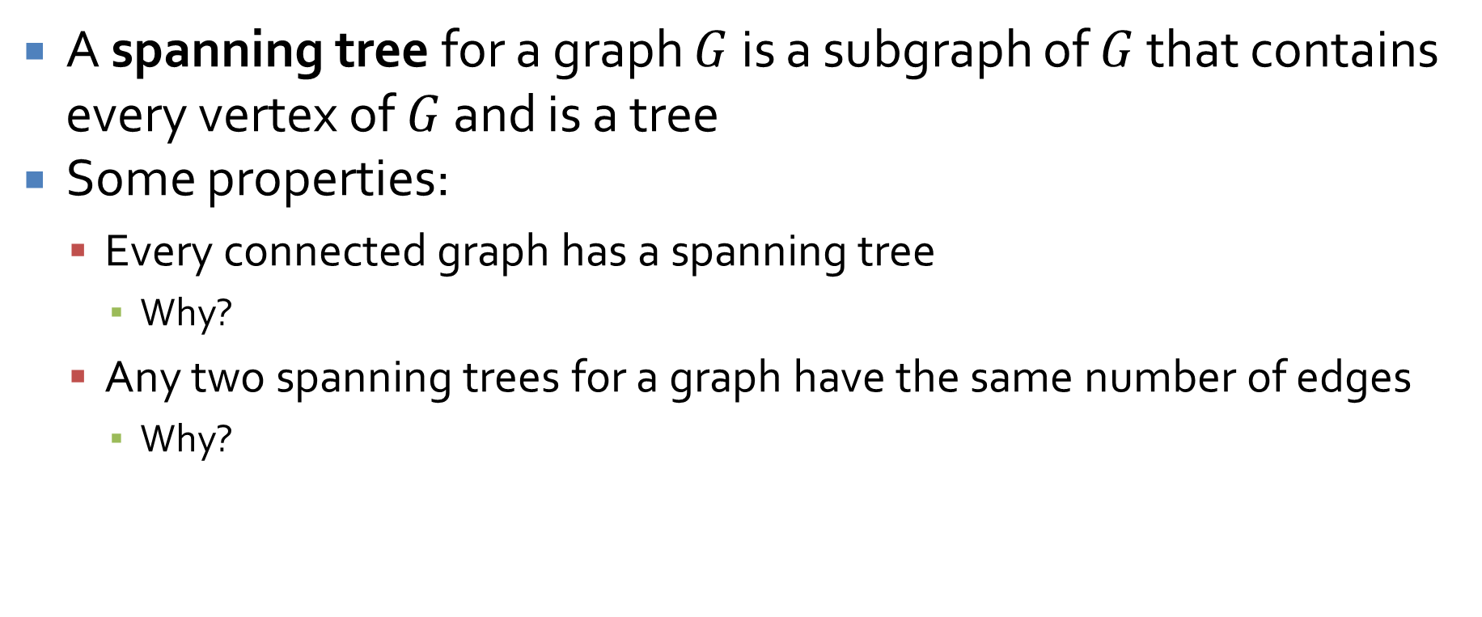
Spanning trees
A spanning tree for a graph $G$ is a subgraph of $G$ that contains every vertex of $G$ and is a tree
Some properties:
  Every connected graph has a spanning tree
    Why?
  Any two spanning trees for a graph have the same number of edges
    Why?

Slide 27
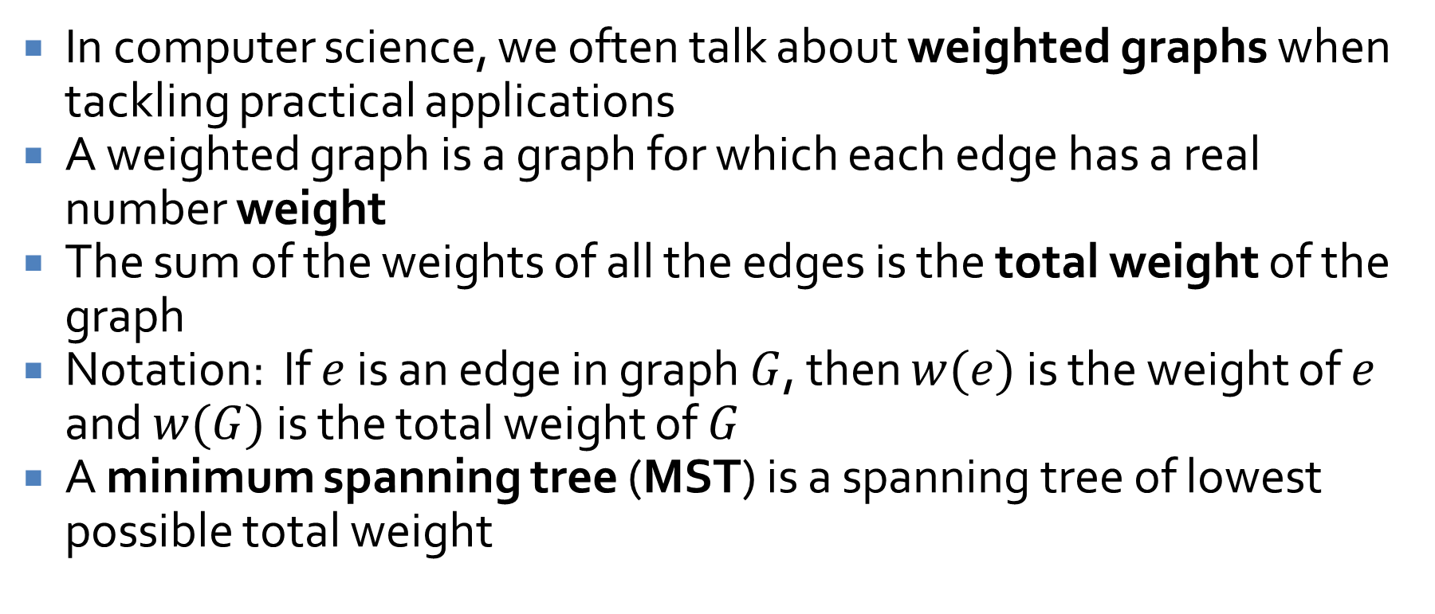
Weighted graphs
In computer science, we often talk about weighted graphs when tackling practical applications
A weighted graph is a graph for which each edge has a real number weight
The sum of the weights of all the edges is the total weight of the graph
Notation: If $e$ is an edge in graph $G$, then $w(e)$ is the weight of $e$ and $w(G)$ is the total weight of $G$
A minimum spanning tree (MST) is a spanning tree of lowest possible total weight

Slide 28
Weighted graphs example
Here is the graph from before, with labeled weights
Detroit
Minneapolis
355
Milwaukee
74
230
695
306
348
Chicago
262
269
Cincinnati
83
242
Louisville
St. Louis
151
Nashville

Slide 29
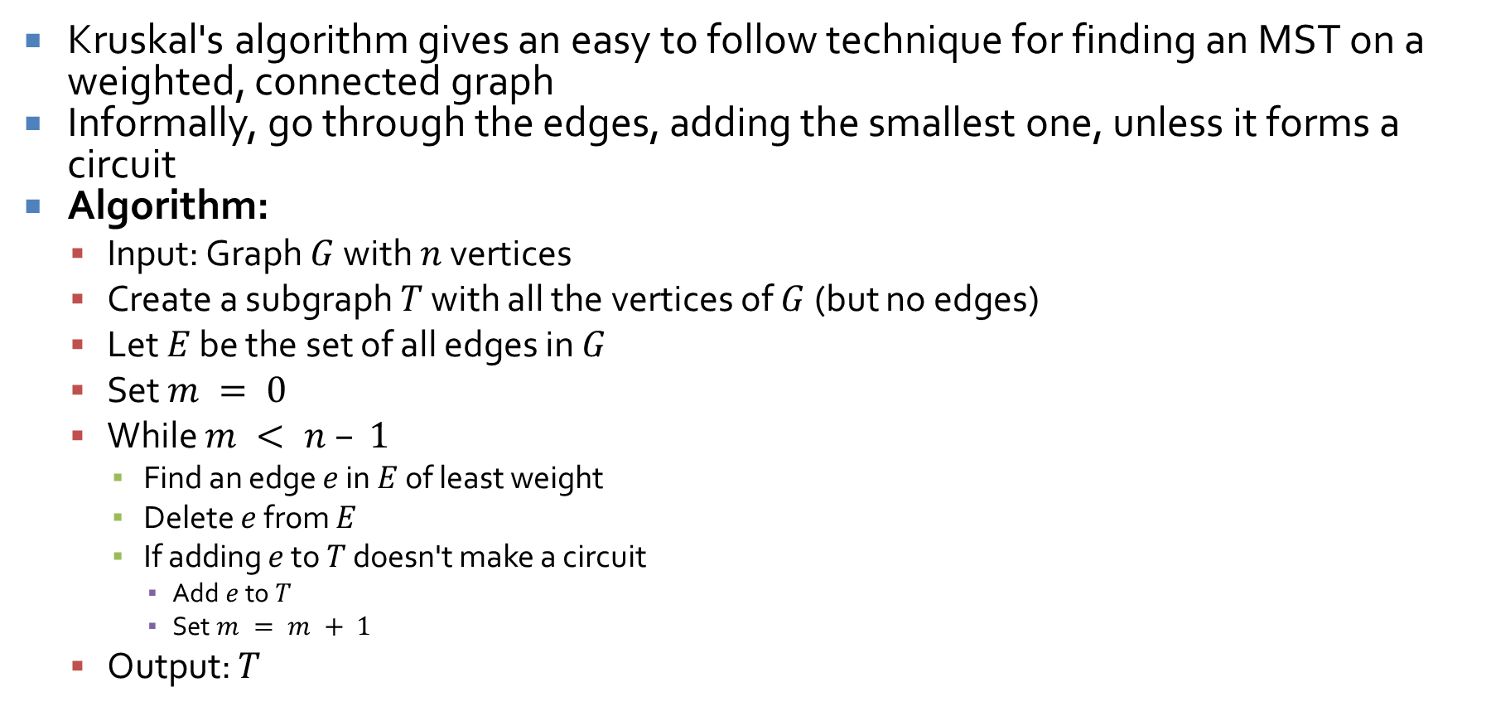
Finding a minimum spanning tree
Kruskal's algorithm gives an easy to follow technique for finding an MST on a weighted, connected graph
Informally, go through the edges, adding the smallest one, unless it forms a circuit
Algorithm:
  Input: Graph $G$ with $n$ vertices
  Create a subgraph $T$ with all the vertices of $G$ (but no edges)
  Let $E$ be the set of all edges in $G$
  Set $m = 0$
  While $m < n – 1$
    Find an edge $e$ in $E$ of least weight
    Delete $e$ from $E$
    If adding $e$ to $T$ doesn't make a circuit
      Add $e$ to $T$
      Set $m = m + 1$
  Output: $T$

Slide 30
Minimum spanning tree example
Run Kruskal's algorithm on the city graph:
Detroit
Minneapolis
355
Milwaukee
74
230
695
306
348
Chicago
262
269
Cincinnati
83
242
Louisville
St. Louis
151
Nashville

Slide 31
Minimum spanning tree output
Output:
Detroit
Minneapolis
355
Milwaukee
74
230
Chicago
262
Cincinnati
83
242
Louisville
St. Louis
151
Nashville

Slide 32
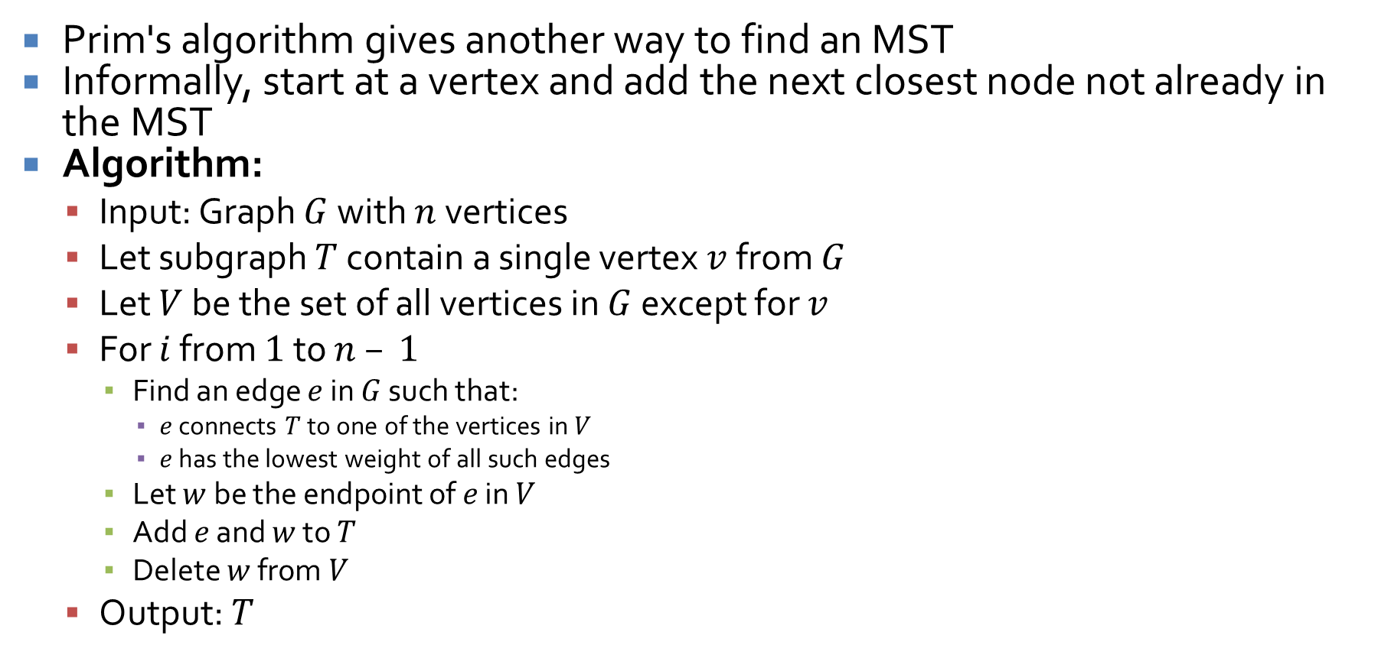
Prim's algorithm
Prim's algorithm gives another way to find an MST
Informally, start at a vertex and add the next closest node not already in the MST
Algorithm:
  Input: Graph $G$ with $n$ vertices
  Let subgraph $T$ contain a single vertex $v$ from $G$
  Let $V$ be the set of all vertices in $G$ except for $v$
  For $i$ from $1$ to $n – 1$
    Find an edge $e$ in $G$ such that:
      $e$ connects $T$ to one of the vertices in $V$
      $e$ has the lowest weight of all such edges
    Let $w$ be the endpoint of $e$ in $V$
    Add $e$ and $w$ to $T$
    Delete $w$ from $V$
  Output: $T$

Slide 33
Prim fights Kruskal
Apply Kruskal's algorithm to the graph below
Now, apply Prim's algorithm to the graph below
Is there any other MST we could make?
2
3
1
4
1
3
1

Slide 34
Ticket Out the Door

Slide 35
Upcoming

Slide 36
Next time…
Graphing functions
Big-O, Big-Omega, and Big-Theta notation

Slide 37
Reminders
Work on Assignment 5
Read 11.1 and 11.2
  Prepare a three-sentence summary
  Extra credit if you get called on

